Slide 1






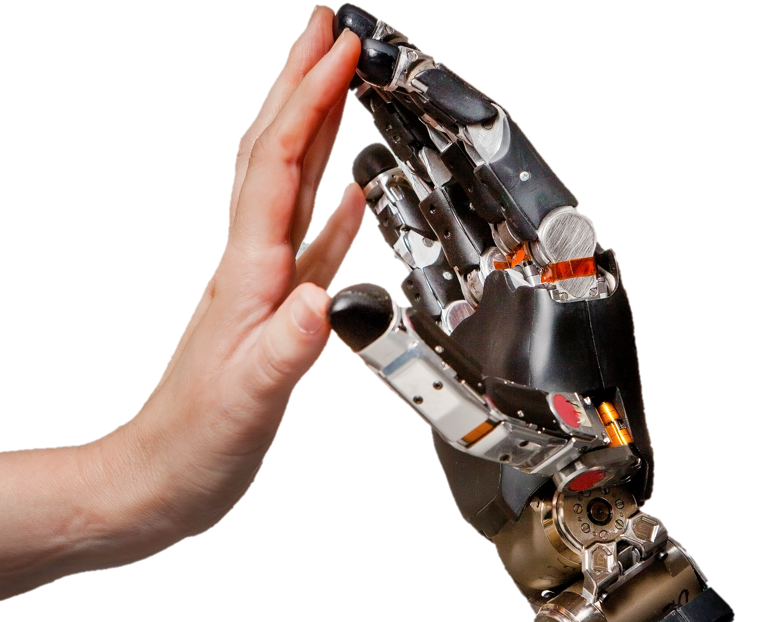
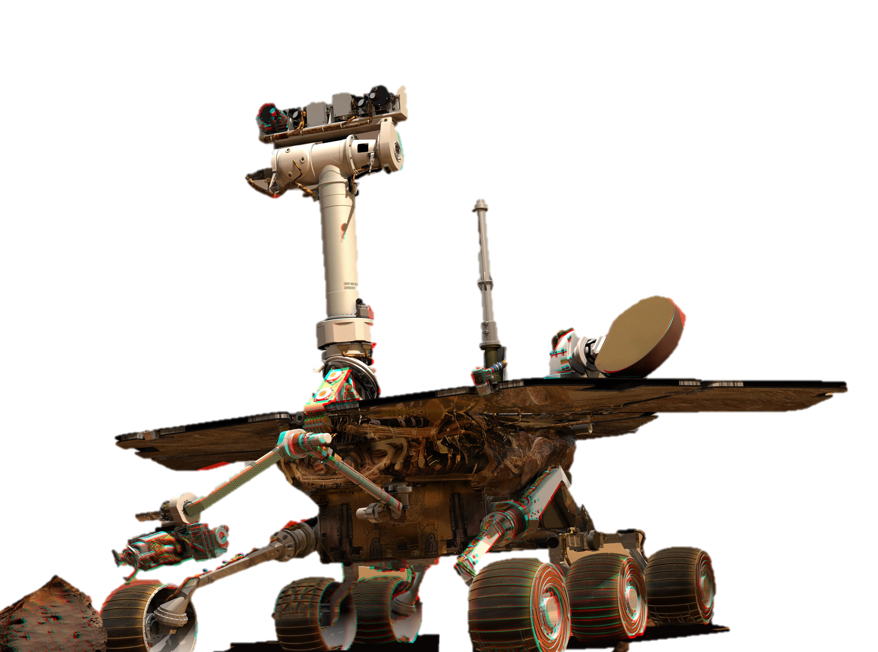

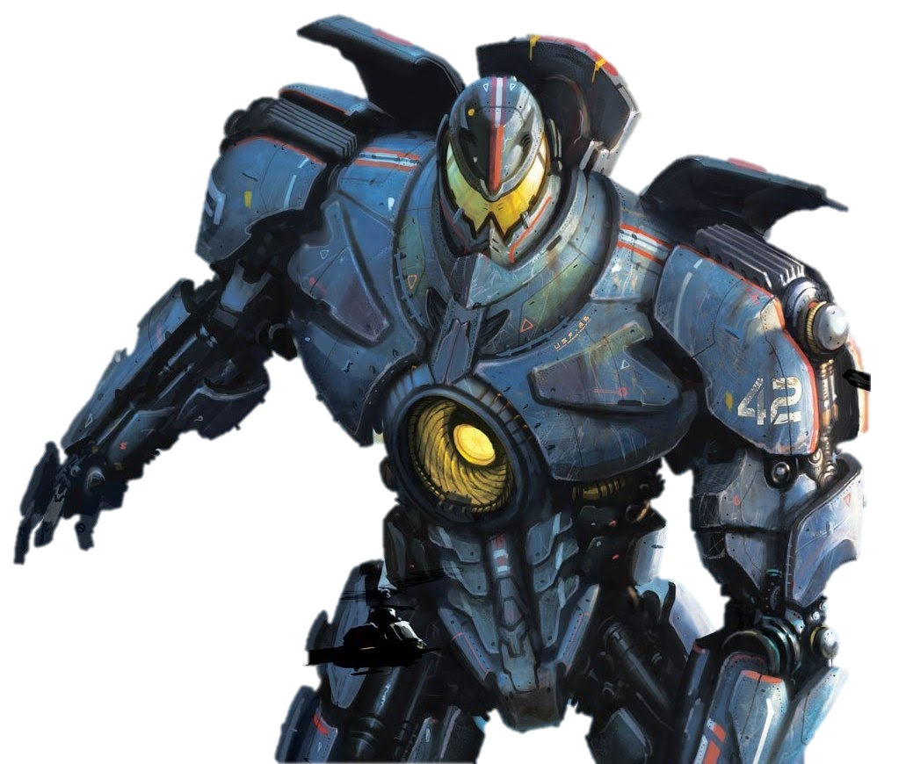
Transforming the Senses
Applications for Artificial Sensory Systems
MAKING SENSE TODAY
MAKING SENSE TOMORROW
The current Making Sense prototype uses an Android interface and an Arduino microcontroller to display pressure and temperature data in real-time.
Future prototypes will combine additional sensors with new feedback mechanisms in a small, battery-powered package to provide more functional natural alerts.
Empower prosthetic devices
Technology like Making Sense will bring essential sensory abilities to prosthetics. By simulating natural function, artificial senses will allow users to perform activities that would be impossible with less advanced devices. This next generation of devices will help people grasp the future.
Experience new worlds
The introduction of artificial sensation will bring touch to new places. From the Martian to the microscopic, this technology will help users feel in places where it was never possible before!
Enhance human experiences
New sensory tech will surpass the impossible by expanding human potential and advancing the human condition. By magnifying human senses, we will usher in a new age of robotics and human augmentation.
BMES

